Slide 1
Stroke Prediction
Sumaya Al Muhannah

Slide 2
01
02
03
INTROUDUCTION
DATASET
DATA PROCESSING
04
CONCLUSIONS
05
MODELING

Slide 3
INTRODUCTION

Slide 4
Stroke is the sudden death of some brain cells due to lack of oxygen when the blood flow to the brain is lost by blockage or rupture of an artery to the brain, it is also a leading cause of dementia and depression.

Slide 5
DATASET

Slide 6
Dataset is used to predict whether a person is likely to get stroke based on the input parameters like gender, age, various diseases, and smoking status

Slide 7
DATA PROCESSING

Slide 8
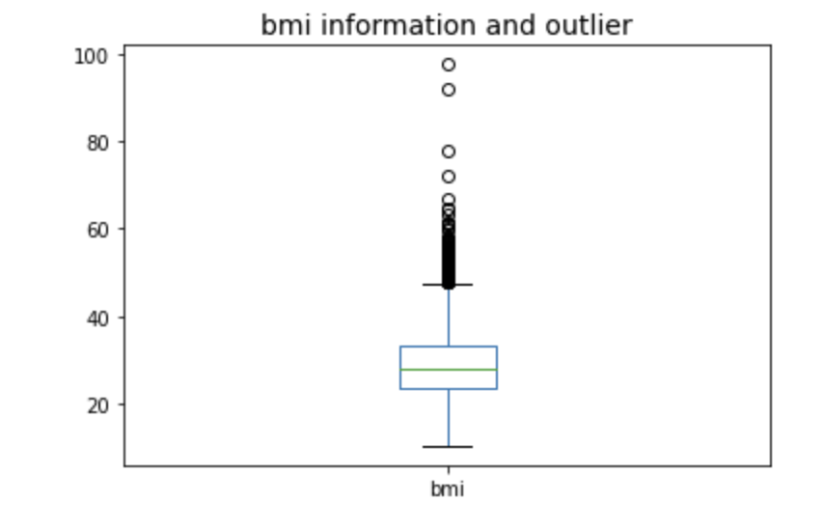
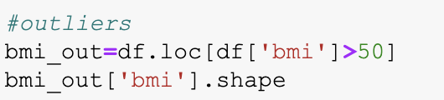

Slide 9
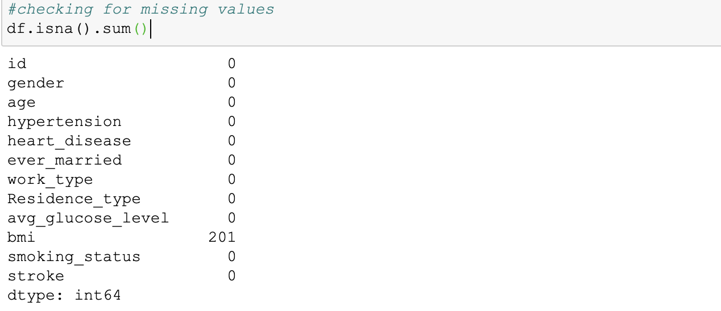
Clean data
Checking for null values.

Slide 10
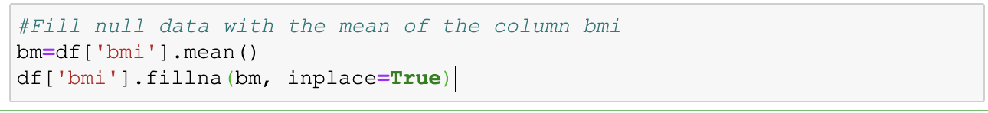
Clean data
Fill null values.

Slide 11
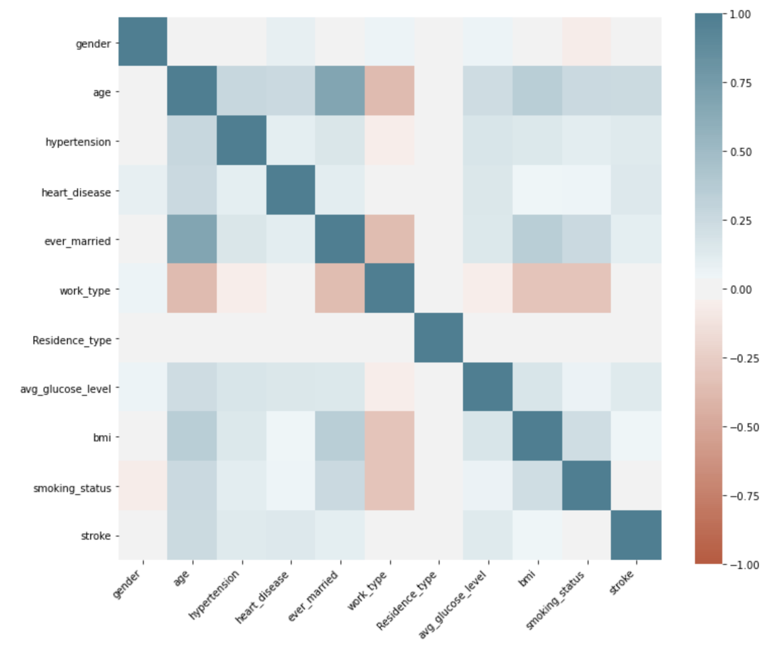
Data Analysis
See the correlation between attributes to see the relation between them

Slide 12
MODELING

Slide 13
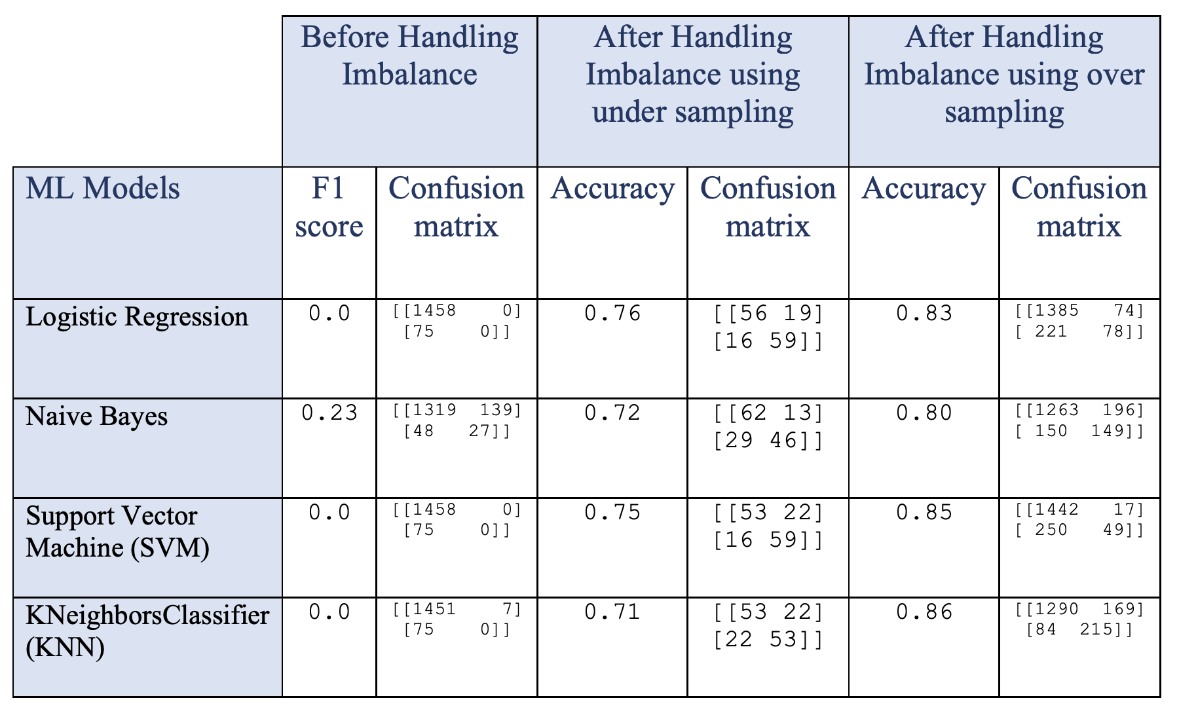

Slide 14
CONCLUSIONS

Slide 15
Naive Bayes model before handling imbalance yields a good performance as indicated by the model F1 score which was found to be 0.23. After handling imbalance using under sampling Logistic Regression model yields a good performance as indicated by the model accuracy which was found to be 0.76. After handling imbalance using over sampling KNN model yields a good performance as indicated by the model accuracy which was found to be 0.86. It is clear from the above table that the accuracy is better after handling imbalance using over sampling.

Slide 16
THANKS!
Any questions?

